Slide 1
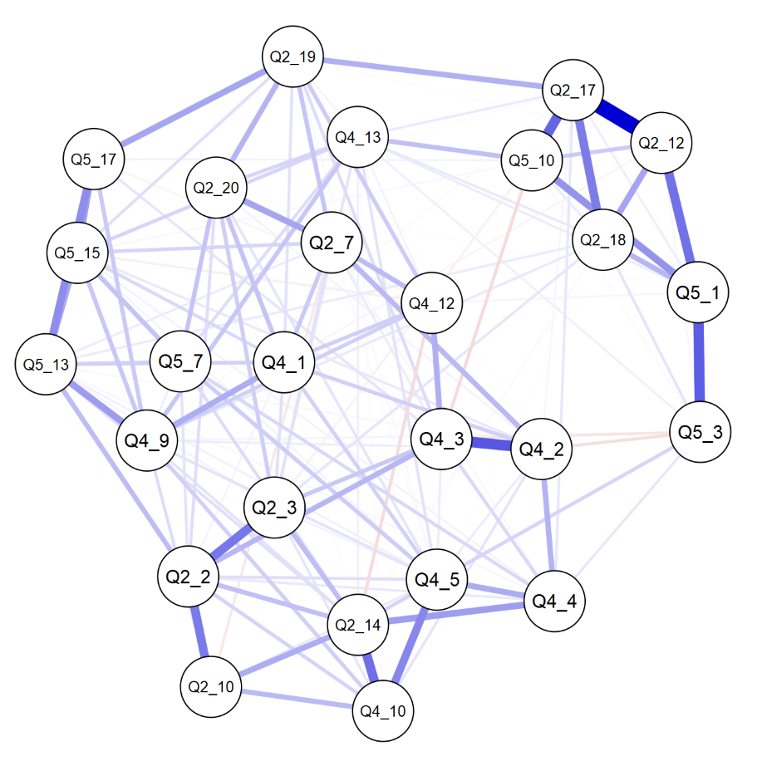
LIFE GOES ON:
Developing a Model for Sense of Immortality
Ari L. Cunningham
Missouri State University
Brooke N. Watson
Missouri State University
Background & Significance
Results
Generativity was first proposed by Erik Erikson as part of his eight-stage model of development (1959). Originally representing a person’s concern for nurturing and leaving something behind for future generations, the concept has broadened in more recent research to include thoughts about the impact and continuity of one’s life (sense of immortality).
In the mortality salience paradigm of terror management theory, people attempt to reduce awareness of mortality through personal and social buffers. These buffers, including self-esteem and favoritism of those with similar worldviews, are thought to decrease a person's awareness of death (Rosenblatt et al., 1989, Greenberg et al., 1990).
Though there is one existing scale related to generativity or sense of immortality, the Sense of Symbolic Immortality Scale (Drolet, 1990), the development and implementation of the scale has been problematic.
We would like to develop a scale that addresses this gap in assessment. A set of questions had previously been assessed for factor structure through exploratory factor analysis.
Step 1: Original model including all questions on the factors they loaded on based on EFA
Step 2: Used modification indices to adjust the model
Cross-loaded if it made theoretical sense to do so
Kept on one factor if better theoretically and needed to assess a unique construct
Removed if cross-loading did not make theoretical sense and was redundant with other items
Step 3: Used theory to simplify the model and to improve fit indices
Removed items if crossloading in step 2 did not help fit enough
Removed if redundant with other items or theoretically did not fit the original factor
We ended up including 7 items in the Literal factor, 10 items in the Personal factor, and 10 items in the Collective factor.
Fit indices for each step are shown in the table to the right.
 | Step 1 | Step 2 | Step 3
RMSEA | .074 | .069 | .061
SRMR | .081 | .060 | .055
CFI | .827 | .864 | .911
TLI | .817 | .854 | .900
Chi-sq | 2273.33 | 1482.60 | 701.70
p | p < .001 | p < .001 | p < .001
Network Plot
Cluster in the top right represents the Literal Immortality factor. Large cluster on the left represents the overlapping Personal and Collective Generativity factors.
Method
Data Collection
Data was collected using MTurk and SONA.
Data was collected between March 1, 2018 and May 10, 2018.
Participants
325 total participants: 93 from Mturk, 232 from SONA
Age ranged from 18 to 68, with an average of 24.54 (SD = 10.00)
For Mturk participants, M = 36.68 (SD = 10.93)
For SONA participants, M = 19.66 (SD = 3.04)
Measures
Items were presented as statements to which participants either agreed
or disagreed.
Response scale of 1 (Strongly Disagree) to 5 (Strongly Agree)
Included a Neutral option
Discussion
After adjusting the model based on modification indices and further simplifying it based on theory, we achieved a model with acceptable fit indices and error.
The Literal Immortality factor stood well on its own, with items hanging together while remaining distinct from other factors. However, the Personal and Collective Generativity factors appear to overlap with one another to a large degree.
The model fit statistics indicate that this scale models generativity in a cohesive way that could be used in further model building such as structural equation modeling. However, the overlap of two of the factors limits the usability of the subscales for measuring individual attitudes.
Future research might use this model to assess the relationship of generativity in its various forms to other variables, such as clinical anxiety and depression, or social psychological constructs such as self-esteem.
Factor | # Items | Example Items | α
Literal/Spiritual Immortality | 12 | When I physically die, other parts of me will live on. I am comforted by the thought of an afterlife. | .94
Personal Generativity | 13 | I have imparted knowledge and skills on to others. I have cared for people and things which will last a long time. | .87
Collective Generativity | 17 | I am confident in the legacy I will leave when I die. I have contributed to the world in a unique way. | .94
References
Drolet, J.L. (1990). Transcending death during early adulthood: Symbolic immortality, death anxiety, and purpose in life. Journal of Clinical Psychology, 46(2), 148–16
Erikson, Erik H. (1959) Identity and the Life Cycle. New York: International Universities Press
Greenberg, J., Pyszczynski, T., Solomon, S., Rosenblatt, A., Veeder, M., Kirkland, S., & Lyon, D. (1990). Evidence for terror management theory II: The effects of mortality salience on reactions to those who threaten or bolster the cultural worldview. Journal of Personality and Social Psychology, 58(2), 308–318.
Rosenblatt, A., Greenberg, J., Solomon, S., Pyszczynski, T., & Lyon, D. (1989). Evidence for terror management theory: I The effects of mortality salience on reactions to those who violate or uphold cultural values. Journal of Personality and Social Psychology, 57(4), 681–690.

